Slide 1

Guide to Networking Essentials 7th Edition
Topic 02
Network Media
Notes:
Network+ Guide to Networks 7th Edition
Chapter 4
Network Media

Slide 2
Objectives
Define the primary cables used in wired networking
Describe the characteristics of the major types of fiber-optic media
Explain the technologies used for wireless networking
Notes:
Objectives
Define the primary cables used in wired networking
Describe the characteristics of the major types of fiber-optic media
Explain the technologies used for wireless networking

Slide 3
Wired Networking
Wired networking uses tangible physical media called cables
Two broad categories of cables: copper wire and fiber optic
The main differences between the two types:
Composition of signals (electricity or light)
Speed at which signals can be sent
Distance the signals can effectively travel
Notes:
Wired Networking
Wired networking uses tangible physical media called cables
Two broad categories of cables: copper wire and fiber optic
The main differences between the two types:
Composition of signals (electricity or light)
Speed at which signals can be sent
Distance the signals can effectively travel

Slide 4
Criteria for Choosing Network Media
Bandwidth Rating – number of bits per second that can be transmitted across a medium
A factor determining bandwidth is how bit signals are represented on the medium (called encoding – next slide)
When possible, choose a cabling category that’s compatible with the standard you want to implement now but will support growth and faster speeds
Maximum Segment Length – maximum length of cable between two network devices
Each cable type can transport data only so far before its signals begin to weaken beyond what can be read by a receiving device (called attenuation)
Notes:
Criteria for Choosing Network Media
Bandwidth Rating – number of bits per second that can be transmitted across a medium
A factor determining bandwidth is how bit signals are represented on the medium (called encoding)
When possible, choose a cabling category that’s compatible with the standard you want to implement now but will support growth and faster speeds
Maximum Segment Length – maximum length of cable between two network devices
Each cable type can transport data only so far before its signals begin to weaken beyond what can be read by a receiving device (called attenuation)

Slide 5
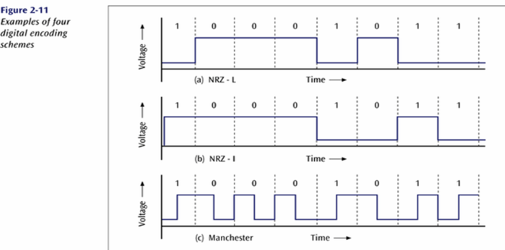
Digital Signal Encoding
Notes:
Not tested – for general knowledge
NRZ-L: low voltage = 1, high voltage = 0
NRZ-I: transition = 1, no transition = 0
Manchester: transition at mid bit second from low to high = 1, transition at mid bit second from high to low = 0
For NRZ-L and NRZ-I, transmitting continuously “0s” or “1s” may cause sender and receiver to loose synchronisation. Must pause in between to allow sender and receiver to resynchronise.
Whereas for Manchester encoding sender and receiver are always synchronise because there is always a transition at the mid bit second for every single bit.

Slide 6
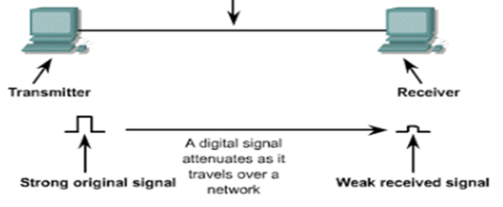
Criteria for Choosing Network Media
Maximum Segment Length – maximum length of cable between two network devices (called cable segment)
Any intermediate passive devices, such as wall jacks, are part of the total segment length (see slide 25)
Each cable type can transport data only so far before its signals begin to weaken beyond what can be read by a receiving device (called attenuation)
Notes:
Criteria for Choosing Network Media
Maximum Segment Length – maximum length of cable between two network devices (called cable segment)
Any intermediate passive devices, such as wall jacks, are part of the total segment length
Each cable type can transport data only so far before its signals begin to weaken beyond what can be read by a receiving device (called attenuation)

Slide 7
Criteria for Choosing Network Media
Interference and Eavesdropping Susceptibility
Interference to electrical signals on copper media comes in the form of electromagnetic interference (EMI) and radio frequency interference (RFI)
Motors, transformers, fluorescent lights and other sources of intense electrical activity can emit both EMI and RFI.
RFI can also affect wireless networks if the frequencies are in the same range
Crosstalk - interference one wire generates on another wire when both wires are in a bundle
Copper wire is susceptible to electronic eavesdropping
Fiber-optic media carries light signals and is not susceptible to interference or eavesdropping
Notes:
Criteria for Choosing Network Media
Interference and Eavesdropping Susceptibility
Interference to electrical signals on copper media comes in the form of electromagnetic interference (EMI) and radio frequency interference (RFI)
Motors, transformers, fluorescent lights and other sources of intense electrical activity can emit both EMI and RFI.
RFI can also affect wireless networks if the frequencies are in the same range
Crosstalk - interference one wire generates on another wire when both wires are in a bundle
Copper wire is susceptible to electronic eavesdropping
Fiber-optic media carries light signals and is not susceptible to interference or eavesdropping

Slide 8
Criteria for Choosing Network Media
Cable Grade
Building and fire codes include specific cabling requirements
Cables ran between a false ceiling and the true ceiling (plenum) must be plenum-rated
UTP Cabling is marked as communication cable riser (CMR) or communication cable plenum (CMP)
CMR can only be used for building risers or in cable trays
CMP is suitable for use in plenum spaces
Notes:
Criteria for Choosing Network Media
Cable Grade
Building and fire codes include specific cabling requirements
Cables ran between a false ceiling and the true ceiling (plenum) must be plenum-rated
UTP Cabling is marked as communication cable riser (CMR) or communication cable plenum (CMP)
CMR can only be used for building risers or in cable trays
CMP is suitable for use in plenum spaces
A space lying above the ceiling in a building but below the next floor, especially oneallowing movement of air between parts of the building.

Slide 9
Criteria for Choosing Network Media
Connection Hardware
Every type of cable has connectors that influence the kinds of hardware the cable can connect to
You must make sure the media you select can be supported by the network device
Notes:
Criteria for Choosing Network Media
Connection Hardware
Every type of cable has connectors that influence the kinds of hardware the cable can connect to
You must make sure the media you select can be supported by the network device

Slide 10
Other Media Considerations
Ease of installation – factors to consider:
Media’s minimum bend radius, which limits the angle at which a cable can be bent to run around corners
Cost and time needed to terminate the medium
Physical environment – types of walls and ceilings, EMI or RFI
Testability – A network that “works” might be crippled by excessive errors
It is important to certify whether the cable meets requirements for its category
Total cost – includes cabling, connectors, termination panels, wall jacks, termination tools, testing equipment and time
Notes:
Other Media Considerations
Ease of installation – factors to consider:
Media’s minimum bend radius, which limits the angle at which a cable can be bent to run around corners
Cost and time needed to terminate the medium
Physical environment – types of walls and ceilings, EMI or RFI
Testability – A network that “works” might be crippled by excessive errors
It is important to certify whether the cable meets requirements for its category
Total cost – includes cabling, connectors, termination panels, wall jacks, termination tools, testing equipment and time

Slide 11
Coaxial Cable
Often called “coax” for short
Once was the predominant form of network cabling
Inexpensive and easy to install
Started to phase out in the early 1990’s
Still used primarily in connecting a cable modem to the wall outlet your cable TV/Internet provider installs
Notes:
Coaxial Cable
Often called “coax” for short
Once was the predominant form of network cabling
Inexpensive and easy to install
Started to phase out in the early 1990’s
Still used primarily in connecting a cable modem to the wall outlet your cable TV/Internet provider installs

Slide 12
Twisted-Pair Cable
Comes in two types: unshielded and shielded
Consists of one or more pairs of insulated strands of copper wires twisted around one another and housed in an outer jacket
Twists are necessary to improve resistance to crosstalk from wires and EMI from outside sources
The more twists per unit length, the better resistance to EMI and crosstalk
More expensive TP is twisted more than less expensive and provides a better pathway for higher bandwidth networks
Notes:
Twisted-Pair Cable
Comes in two types: unshielded and shielded
Consists of one or more pairs of insulated strands of copper wires twisted around one another and housed in an outer jacket
Twists are necessary to improve resistance to crosstalk from wires and EMI from outside sources
The more twists per unit length, the better resistance to EMI and crosstalk
More expensive TP is twisted more than less expensive and provides a better pathway for higher bandwidth networks

Slide 13
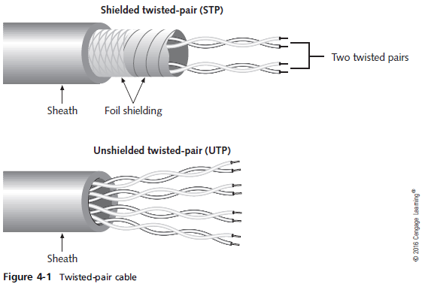
Twisted-Pair Cable
Notes:
Twisted-Pair Cable

Slide 14
Unshielded Twisted-Pair Cable
Most networks use Unshielded Twisted-Pair (UTP)
Consists of four pairs of insulated wires
Rated according to categories devised by the Telecommunications Industry Association (TIA) and Electronic Industries Alliance (EIA) and American National Standards Institutes (ANSI)
Categories 1 – 6a are accepted in US
Two additional categories aren’t yet TIA/EIA standards and might never be in US
Europe has accepted Category 7 and 7a, which specify that each wire pair is shielded
Notes:
Unshielded Twisted-Pair Cable
Most networks use Unshielded Twisted-Pair (UTP)
Consists of four pairs of insulated wires
Rated according to categories devised by the Telecommunications Industry Association (TIA) and Electronic Industries Alliance (EIA) and American National Standards Institutes (ANSI)
Categories 1 – 6a are accepted in US
Two additional categories aren’t yet TIA/EIA standards and might never be in US
Europe has accepted Category 7 and 7a, which specify that each wire pair is shielded

Slide 15
Categories of UTP Cables

Slide 16
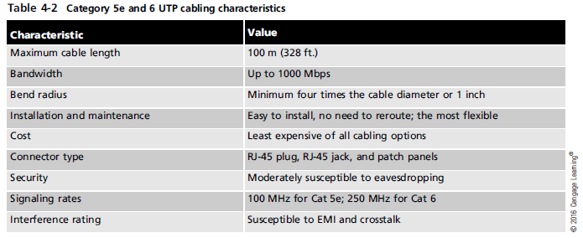
Unshielded Twisted-Pair Cable
Categories 5e and 6 UTP Cabling Characteristics
These categories are the most popular types of UTP cabling in today’s networks
Notes:
Unshielded Twisted-Pair Cable
Categories 5e and 6 UTP Cabling Characteristics
These categories are the most popular types of UTP cabling in today’s networks

Slide 17
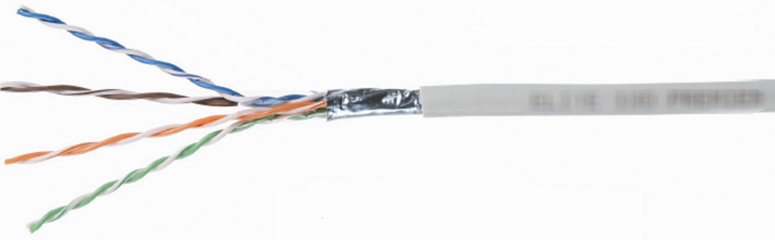
Shielded Twisted-Pair Cable
Includes shielding to reduce crosstalk and interference
Has a wire braid inside the sheath material or a foil wrap
Best to use in electrically noisy environments or very high-bandwidth applications
Notes:
Shielded Twisted-Pair Cable
Includes shielding to reduce crosstalk and interference
Has a wire braid inside the sheath material or a foil wrap
Best to use in electrically noisy environments or very high-bandwidth applications

Slide 18
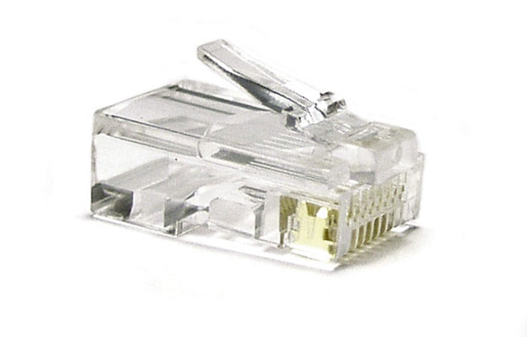
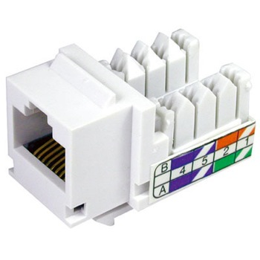
Twisted-Pair Cable Plant Components
RJ-45 Connectors – STP and UTP uses registered jack 45 (RJ-45)
Most commonly used in patch cables, which are used to connect computers to hubs, switches, and RJ-45 wall jacks
RJ-45 jacks – what you plug an RJ-45 connector into when the computer is not near a switch or hub
Usually placed behind wall plates when cables are run inside walls
Notes:
Twisted-Pair Cable Plant Components
RJ-45 Connectors – STP and UTP uses registered jack 45 (RJ-45)
Most commonly used in patch cables, which are used to connect computers to hubs, switches, and RJ-45 wall jacks

Slide 19
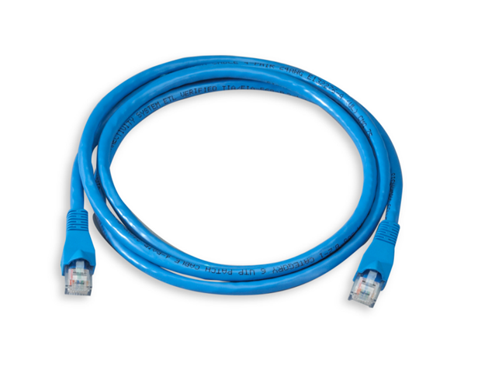
Twisted-Pair Cable Plant Components
Patch cable – short cable for connecting a computer to an RJ-45 wall jack or connecting a patch-panel port to a switch or hub
Can be made with inexpensive tools, two RJ-45 plugs and a length of TP cable
Notes:
Twisted-Pair Cable Plant Components
Patch cable – short cable for connecting a computer to an RJ-45 wall jack or connecting a patch-panel port to a switch or hub
Can be made with inexpensive tools, two RJ-45 plugs and a length of TP cable

Slide 20
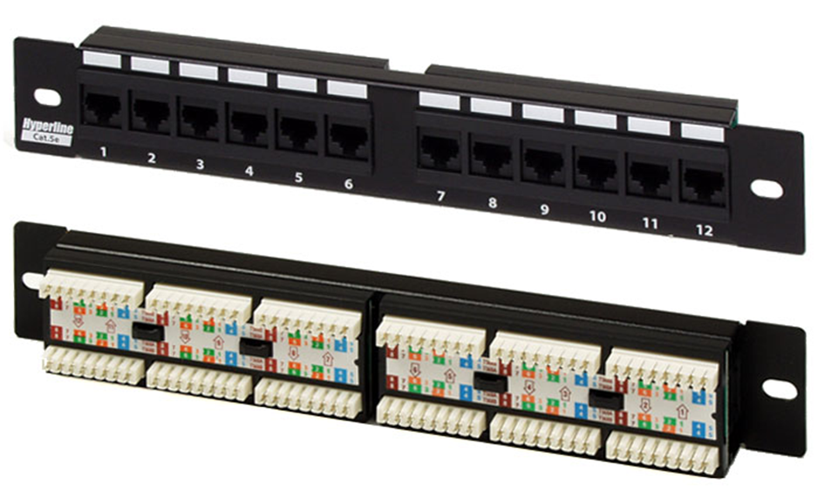
Twisted-Pair Cable Plant Components
Patch Panels – used to terminate long runs of cable from where the computers are to the wiring closet (where the switches and hubs are)
Notes:
Twisted-Pair Cable Plant Components
Patch Panels – used to terminate long runs of cable from where the computers are to the wiring closet (where the switches and hubs are)
Distribution racks – hold network equipment such as routers and switches, plus patch panels and rack-mounted servers
Also called 19” racks because the upright rails are 19” apart

Slide 21
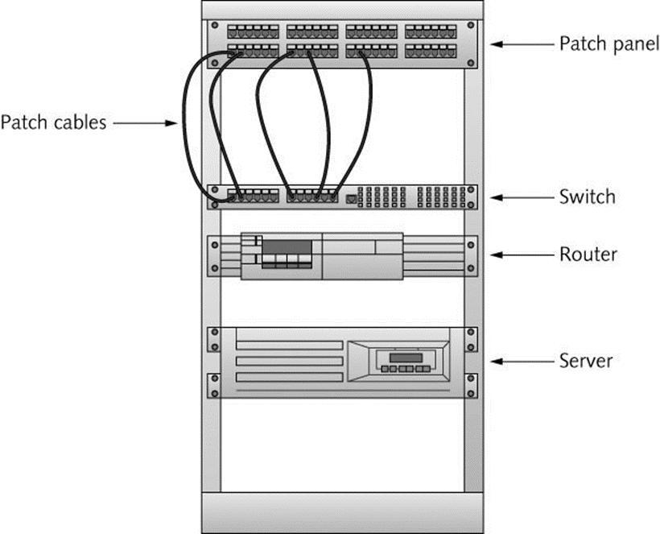
Twisted-Pair Cable Plant Components
Distribution racks – hold network equipment such as routers and switches, plus patch panels and rack-mounted servers
Also called 19” racks because the upright rails are 19” apart
Notes:
Twisted-Pair Cable Plant Components
Patch Panels – used to terminate long runs of cable from where the computers are to the wiring closet (where the switches and hubs are)
Distribution racks – hold network equipment such as routers and switches, plus patch panels and rack-mounted servers
Also called 19” racks because the upright rails are 19” apart

Slide 22
Structured Cabling: Managing and Installing a UTP Cable Plant
Structured cabling specifies how cabling should be organized, regardless of the media type or network architecture
Large networks typically use most or all of these:
Work area
Horizontal wiring
Telecommunication closets
Equipment rooms
Backbone or vertical wiring
Entrance facilities
Notes:
Structured Cabling: Managing and Installing a UTP Cable Plant
Structured cabling specifies how cabling should be organized, regardless of the media type or network architecture
Large networks typically use most or all of these:
Work area
Horizontal wiring
Telecommunication closets
Equipment rooms
Backbone or vertical wiring
Entrance facilities

Slide 23
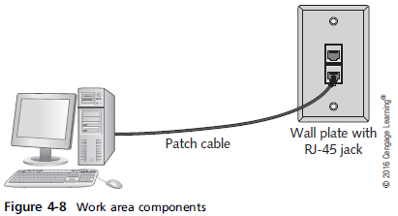
Structured Cabling: Managing and Installing a UTP Cable Plant
Work Area – where workstations and other user devices are located
Faceplates and wall jacks are installed in the work area
Patch cable connect computers and printers to wall jacks
Notes:
Structured Cabling: Managing and Installing a UTP Cable Plant
Work Area – where workstations and other user devices are located
Faceplates and wall jacks are installed in the work area
Patch cable connect computers and printers to wall jacks

Slide 24
Structured Cabling: Managing and Installing a UTP Cable Plant
Horizontal wiring – runs from the work area’s wall jack to the telecommunication closet
Wiring from the wall jack to the patch panel should be no longer than 90 meters (plus 10 meters for patch cables)
Telecommunications Closet
TC provides connectivity to computer equipment in the nearby work area
Typical equipment includes patch panels to terminate horizontal wiring runs, hubs and switches
A TC that houses the cabling and devices for work area computers is referred to as an intermediate distribution frame (IDF)
Notes:
Structured Cabling: Managing and Installing a UTP Cable Plant
Horizontal wiring – runs from the work area’s wall jack to the telecommunication closet
Wiring from the wall jack to the patch panel should be no longer than 90 meters (plus 10 meters for patch cables)
Telecommunications Closet
TC provides connectivity to computer equipment in the nearby work area
Typical equipment includes patch panels to terminate horizontal wiring runs, hubs and switches
A TC that houses the cabling and devices for work area computers is referred to as an intermediate distribution frame (IDF)

Slide 25
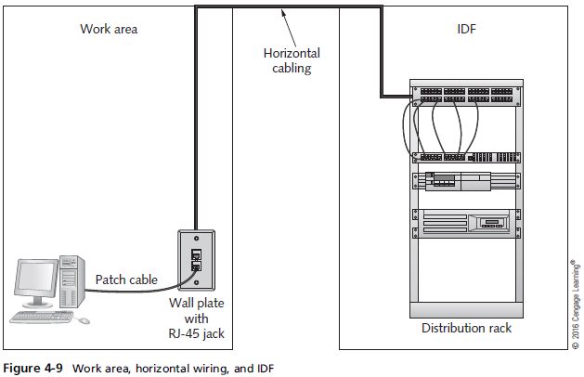
Structured Cabling: Managing and Installing a UTP Cable Plant
Notes:
Structured Cabling: Managing and Installing a UTP Cable Plant

Slide 26
Structured Cabling: Managing and Installing a UTP Cable Plant
Equipment Room – houses servers, routers, switches, and other major network equipment and serves as a connection point for backbone cabling
An equipment room that’s the connection point between IDFs is called a main distribution frame (MDF)
An MDF can be the main cross-connect for the entire network or it might serve as the connecting point for backbone cabling between buildings
Each building often has its own MDF
Notes:
Structured Cabling: Managing and Installing a UTP Cable Plant
Equipment Room – houses servers, routers, switches, and other major network equipment and serves as a connection point for backbone cabling
An equipment room that’s the connection point between IDFs is called a main distribution frame (MDF)
An MDF can be the main cross-connect for the entire network or it might serve as the connecting point for backbone cabling between buildings
Each building often has its own MDF

Slide 27
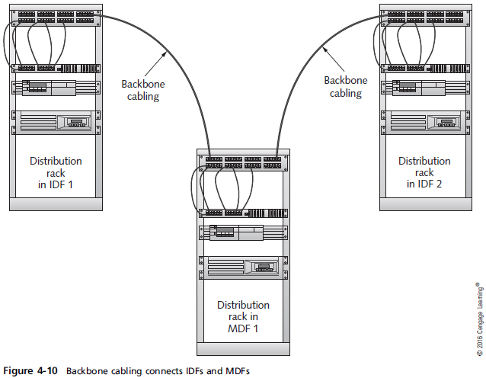
Structured Cabling: Managing and Installing a UTP Cable Plant
Backbone Cabling – interconnects IDFs and MDFs
Runs between floors or wings of a building and between buildings
Frequently fiber-optic cable but can also be UTP if the distance between TCs is less than 90 meters
Notes:
Structured Cabling: Managing and Installing a UTP Cable Plant
Backbone Cabling – interconnects IDFs and MDFs
Runs between floors or wings of a building and between buildings
Frequently fiber-optic cable but can also be UTP if the distance between TCs is less than 90 meters

Slide 28
Structured Cabling: Managing and Installing a UTP Cable Plant
Entrance Facility – the location of the cabling and equipment that connects a corporate network to a third-party telecommunications provider
Can also serve as an equipment room and the main cross-connect for all backbone cabling
Where a connection to a WAN is made
Demarcation point: point where corporate LAN equipment ends and a third-party provider’s equipment and cabling begins
Notes:
Structured Cabling: Managing and Installing a UTP Cable Plant
Entrance Facility – the location of the cabling and equipment that connects a corporate network to a third-party telecommunications provider
Can also serve as an equipment room and the main cross-connect for all backbone cabling
Where a connection to a WAN is made
Demarcation point: point where corporate LAN equipment ends and a third-party provider’s equipment and cabling begins

Slide 29
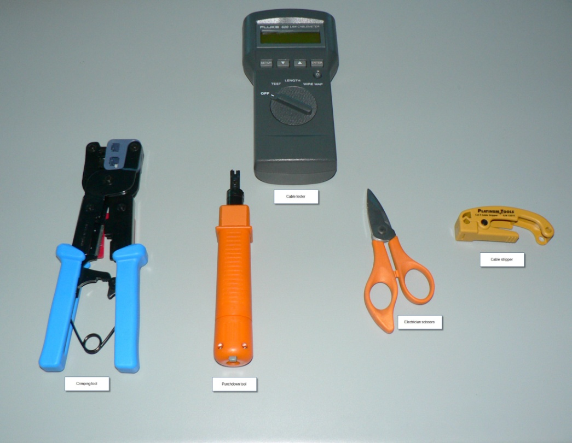
Installing UTP Cabling
Cable termination – putting RJ-45 plugs on the ends of cable or punching down wires into terminal blocks on a jack or patch panel
Some tools
needed:
Wire cutters
Crimping Tool
Cable Tester
Punchdown Tool
Cable Stripper
RJ-45 plugs/jacks
Notes:
Installing UTP Cabling
Cable termination – putting RJ-45 plugs on the ends of cable or punching down wires into terminal blocks on a jack or patch panel
Some tools
needed:
Wire cutters
Crimping Tool
Cable Tester
Punchdown Tool
Cable Stripper
RJ-45 plugs/jacks

Slide 30
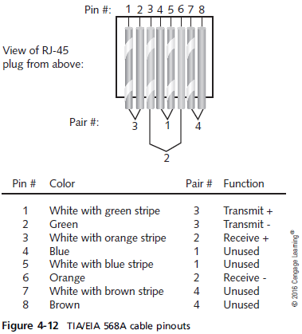
Installing UTP Cabling
When making a cable or terminating a cable at a jack or patch panel
It is important to get the colored wires arranged in the correct order
There are two standards: 568A and 568B
Notes:
Installing UTP Cabling
When making a cable or terminating a cable at a jack or patch panel
It is important to get the colored wires arranged in the correct order
There are two standards: 568A and 568B

Slide 31
Straight-Through Versus Crossover Cable
Standard patch cables are called straight-through cables (same wiring standard on both ends)
Crossover cables – use 568A standard on one side of the cable and 568B standard on the other side
Crosses the transmit and receive wires so that transmit on one end connects to receive on the other
This type of cable is often needed when you connect two devices of the same type to one another
For a 1000BaseT crossover cable, you have to cross the blue and brown pins because they’re used in 1000BaseT
Notes:
Straight-Through Versus Crossover Cable
Standard patch cables are called straight-through cables (same wiring standard on both ends)
Crossover cables – use 568A standard on one side of the cable and 568B standard on the other side
Crosses the transmit and receive wires so that transmit on one end connects to receive on the other
This type of cable is often needed when you connect two devices of the same type to one another
For a 1000BaseT crossover cable, you have to cross the blue and brown pins because they’re used in 1000BaseT

Slide 32
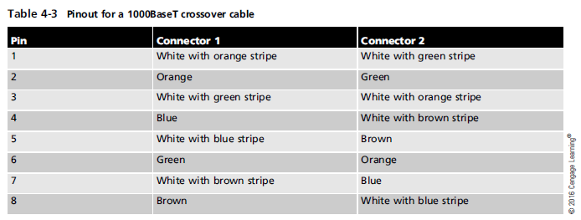
Straight-Through Versus Crossover Cable
Notes:
Straight-Through Versus Crossover Cable

Slide 33
Medium Dependent Interface
Network devices that connect by using RJ-45 plugs over twisted-pair cabling are classified as medium dependent interface (MDI) devices or MDI crossed (MDI-X) devices
MDI devices transmit on pins 1 and 2 and receive on pins 3 and 6
PC NICs and routers are examples
MDI-X devices receive on pins 1 and 2 and transmit on pins 3 and 6
Hubs and switches are examples
When two switches (or any other like devices) need to be connected, you use a crossover cable so that transmit and receive wires get crossed
Notes:
Medium Dependent Interface
Network devices that connect by using RJ-45 plugs over twisted-pair cabling are classified as medium dependent interface (MDI) devices or MDI crossed (MDI-X) devices
MDI devices transmit on pins 1 and 2 and receive on pins 3 and 6
PC NICs and routers are examples
MDI-X devices receive on pins 1 and 2 and transmit on pins 3 and 6
Hubs and switches are examples
When two switches (or any other like devices) need to be connected, you use a crossover cable so that transmit and receive wires get crossed

Slide 34
Why Two Transmit and Two Receive Wires?
One wire pair is used for transmit (labeled transmit+/transmit-) and one pair for receive (labeled receive+/receive-)
The plus and minus symbols indicate that the wires carry a positive and negative signal
This differential signal mitigates the effect of crosstalk and noise on the cable
Notes:
Why Two Transmit and Two Receive Wires?
One wire pair is used for transmit (labeled transmit+/transmit-) and one pair for receive (labeled receive+/receive-)
The plus and minus symbols indicate that the wires carry a positive and negative signal
This differential signal mitigates the effect of crosstalk and noise on the cable

Slide 35
Fiber-Optic Cable
Bits are transmitted as pulses of light instead of electricity
Immune to electrical interference
Highly secure – electronic eavesdropping is eliminated
Composition
A slender cylinder of glass fiber called the core is surrounded by a concentric layer of glass called the cladding
Fiber is then jacketed in a thin transparent plastic material called the buffer
Notes:
Fiber-Optic Cable
Bits are transmitted as pulses of light instead of electricity
Immune to electrical interference
Highly secure – electronic eavesdropping is eliminated
Composition
A slender cylinder of glass fiber called the core is surrounded by a concentric layer of glass called the cladding
Fiber is then jacketed in a thin transparent plastic material called the buffer

Slide 36
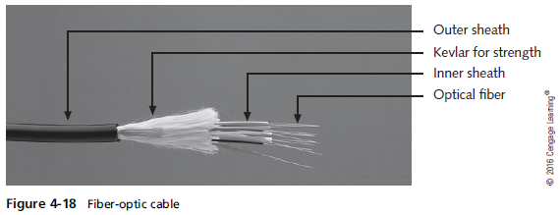
Fiber-Optic Cable
Notes:
Fiber-Optic Cable

Slide 37
Fiber-Optic Cable
Each fiber-optic strand carries data in only one direction
Network connections consist of two or more strands
Fiber-optic cable used as backbone cabling often comes in bundles of 12 or more fiber strands
Even only using 2 in the backbone, running more is a good idea so that you are ready for any future expansion
Some testing has shown that glass fibers can carry several terabits (1000 gigabits) per second
Fiber-optic cable may one day replace copper for all types of network connections
Notes:
Fiber-Optic Cable
Each fiber-optic strand carries data in only one direction
Network connections consist of two or more strands
Fiber-optic cable used as backbone cabling often comes in bundles of 12 or more fiber strands
Even only using 2 in the backbone, running more is a good idea so that you are ready for any future expansion
Some testing has shown that glass fibers can carry several terabits (1000 gigabits) per second
Fiber-optic cable may one day replace copper for all types of network connections

Slide 38
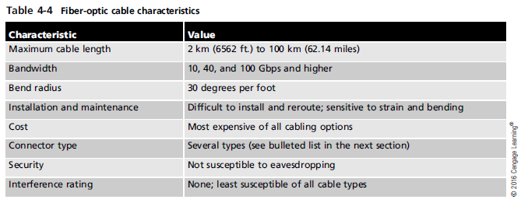
Fiber-Optic Cable
Notes:
Fiber-Optic Cable

Slide 39
Fiber-Optic Connectors
Types of connectors:
Straight tip (ST)
Straight connection (SC)
Locking connection (LC)
Mechanical transfer registered jack (MT-RJ)
Fiber channel or ferrule connector (FC)
Medium interface connector (MIC)
Subminiature type A (SMA)
Notes:
Fiber-Optic Connectors
Types of connectors:
Straight tip (ST)
Straight connection (SC)
Locking connection (LC)
Mechanical transfer registered jack (MT-RJ)
Fiber channel or ferrule connector (FC)
Medium interface connector (MIC)
Subminiature type A (SMA)

Slide 40
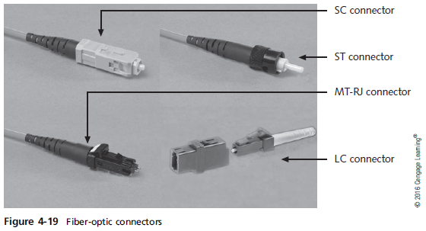
Fiber-Optic Connectors
Notes:
Fiber-Optic Connectors

Slide 41
Fiber-Optic Installation
Somewhat more difficult and time consuming than copper media installation
However, advances in connector technology is closing the gap
Connectors and test equipment required for termination are still more expensive than copper
There are many methods for terminating fiber-optic cables because of the many connectors and cable types available
Installation details are beyond the scope of this book
Notes:
Fiber-Optic Installation
Somewhat more difficult and time consuming than copper media installation
However, advances in connector technology is closing the gap
Connectors and test equipment required for termination are still more expensive than copper
There are many methods for terminating fiber-optic cables because of the many connectors and cable types available
Installation details are beyond the scope of this book

Slide 42
Fiber-Optic Cable Types
Single-mode fiber (SMF)
Includes a single, small-diameter fiber at the core (8 microns)
Generally works with laser-based emitters
Spans the longest distances
Used in higher-bandwidth applications
Multimode fiber (MMF)
Larger diameter fiber at the core (50 and 62.5 microns)
Costs less than SMF
Works with lower-power light emitting diodes (LEDs)
Spans shorter distances
Notes:
Fiber-Optic Cable Types
Single-mode fiber (SMF)
Includes a single, small-diameter fiber at the core (8 microns)
Generally works with laser-based emitters
Spans the longest distances
Used in higher-bandwidth applications
Multimode fiber (MMF)
Larger diameter fiber at the core (50 and 62.5 microns)
Costs less than SMF
Works with lower-power light emitting diodes (LEDs)
Spans shorter distances

Slide 43
Cable-Testing Equipment
Common tools for testing and troubleshooting wired networks:
Cable certifier
Basic cable tester
Tone generator
Time domain reflectometer (TDR)
Multimeter
Optical power meter (OPM)
Notes:
Cable-Testing Equipment
Common tools for testing and troubleshooting wired networks:
Cable certifier
Basic cable tester
Tone generator
Time domain reflectometer (TDR)
Multimeter
Optical power meter (OPM)

Slide 44
Wireless Networking
Demand has increased considerably
Many home users have turned to wireless networks
Wireless networks are often used with wired networks to interconnect geographically dispersed LANs or groups of mobile users with wired servers and resources on a wired LAN (sometimes referred to as “hybrid networks”)
Even in small networks with workstations connecting to a wireless AP or router, the AP or router usually connects to the Internet via a wired connection to a cable modem
Notes:
Wireless Networking
Demand has increased considerably
Many home users have turned to wireless networks
Wireless networks are often used with wired networks to interconnect geographically dispersed LANs or groups of mobile users with wired servers and resources on a wired LAN (sometimes referred to as “hybrid networks”)
Even in small networks with workstations connecting to a wireless AP or router, the AP or router usually connects to the Internet via a wired connection to a cable modem

Slide 45
Wireless Benefits
Creates temporary connections to wired networks
Establishes backup or contingency connectivity for existing wired networks
Extends a network’s span beyond the reach of wire-based or fiber-optic cabling, especially in older buildings where rewiring might be too expensive
Allows businesses to provide customers with wireless networking easily, offering a service that gets customers in and keeps them there
Enables users to roam around a corporate or college campus with their machines
Notes:
Wireless Benefits
Creates temporary connections to wired networks
Establishes backup or contingency connectivity for existing wired networks
Extends a network’s span beyond the reach of wire-based or fiber-optic cabling, especially in older buildings where rewiring might be too expensive
Allows businesses to provide customers with wireless networking easily, offering a service that gets customers in and keeps them there
Enables users to roam around a corporate or college campus with their machines

Slide 46
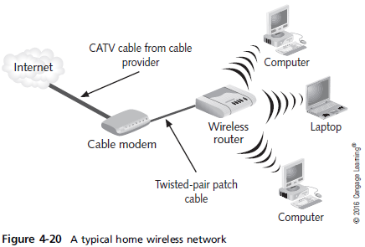
Wireless Benefits
Notes:
Wireless Benefits

Slide 47
Types of Wireless Networks
Local area networks (LANs) – usually provides connectivity for mobile users or across areas that couldn’t otherwise be networked
Extended LANs – usually used to increase a LAN’s span beyond normal distance limitations
Internet service – used to bring Internet access to homes and businesses
Mobile computing – users communicate by using a wireless networking medium that enable them to move while remaining connected to a network
Notes:
Types of Wireless NetworksLocal area networks (LANs) – usually provides connectivity for mobile users or across areas that couldn’t otherwise be networked
Extended LANs – usually used to increase a LAN’s span beyond normal distance limitations
Internet service – used to bring Internet access to homes and businesses
Mobile computing – users communicate by using a wireless networking medium that enable them to move while remaining connected to a network

Slide 48
Wireless LAN Components
Network interface attaches to an antenna and an emitter rather than to a cable
Transceiver/access point (AP) – a transmitter/receiver device that must be installed to translate between wired and wireless networks
Includes an antenna and a transmitter to send and receive wireless traffic but also connects to the wired side of the network
Shuttles traffic back and forth between a network’s wired and wireless sides
Notes:
Wireless LAN Components
Network interface attaches to an antenna and an emitter rather than to a cable
Transceiver/access point (AP) – a transmitter/receiver device that must be installed to translate between wired and wireless networks
Includes an antenna and a transmitter to send and receive wireless traffic but also connects to the wired side of the network
Shuttles traffic back and forth between a network’s wired and wireless sides

Slide 49
Wireless LAN Transmission
Signals take the form of waves in the electromagnetic (EM) spectrum
The frequency of the wave forms used for communication is measured in cycles per second, usually expressed as hertz (Hz)
Lower-frequency transmissions can carry less data more slowly over longer distances, and higher-frequency transmissions can carry more data faster over shorter distances (high frequency radio waves has higher signaling rate)
Notes:
Wireless LAN Transmission
Signals take the form of waves in the electromagnetic (EM) spectrum
The frequency of the wave forms used for communication is measured in cycles per second, usually expressed as hertz (Hz)
Lower-frequency transmissions can carry less data more slowly over longer distances, and higher-frequency transmissions can carry more data faster over shorter distances

Slide 50
Wireless LAN Transmission
The following are the most common frequencies for wireless data communication:
Radio – 10 KHz to 300 MHz
Microwave – 300 MHz to 300 GHz
Infrared – 300 GHz to 400 THz (terahertz)
Wireless LANs make use of four primary technologies for transmitting and receiving data
Infrared
Laser
Narrowband (single-frequency) radio
Spread-spectrum radio
Notes:
Wireless LAN Transmission
The following are the most common frequencies for wireless data communication:
Radio – 10 KHz to 300 MHz
Microwave – 300 MHz to 300 GHz
Infrared – 300 GHz to 400 THz (terahertz)
Wireless LANs make use of four primary technologies for transmitting and receiving data
Infrared
Laser
Narrowband (single-frequency) radio
Spread-spectrum radio

Slide 51
Infrared LAN Technologies
Infrared (IR) wireless networks use infrared light beams to send signals between pairs of devices
Works well for LAN applications due to high bandwidth
Four main kinds of infrared LANs
Line-of-sight networks – require an unobstructed view between transmitter and receiver
Reflective wireless networks – broadcast signals from optical transceivers near devices to a central hub
Scatter infrared networks – bounce transmissions off walls and ceilings to deliver signals
Broadband optical telepoint networks – provide broadband services
Notes:
Infrared LAN Technologies
Infrared (IR) wireless networks use infrared light beams to send signals between pairs of devices
Works well for LAN applications due to high bandwidth
Four main kinds of infrared LANs
Line-of-sight networks – require an unobstructed view between transmitter and receiver
Reflective wireless networks – broadcast signals from optical transceivers near devices to a central hub
Scatter infrared networks – bounce transmissions off walls and ceilings to deliver signals
Broadband optical telepoint networks – provide broadband services

Slide 52
Laser-Based LAN Technologies
Also require a clear line of sight between sender and receiver
Subject to many of the same limitations as infrared
Aren’t as susceptible to interference from visible light sources as infrared
Notes:
Laser-Based LAN Technologies
Also require a clear line of sight between sender and receiver
Subject to many of the same limitations as infrared
Aren’t as susceptible to interference from visible light sources as infrared

Slide 53
Narrowband Radio LAN Technologies
Use low-powered, two-way radio communication
Receiver and transmitter must be tuned to the same frequency to handle incoming and outgoing data
Requires no line of sight between sender and receiver as long as both parties stay within the broadcast range of these devices
Typically 70 meters or 230 feet
Depending on the frequency, walls or other solid barriers can block signals
Interference from other radio sources is possible
Notes:
Narrowband Radio LAN Technologies
Use low-powered, two-way radio communication
Receiver and transmitter must be tuned to the same frequency to handle incoming and outgoing data
Requires no line of sight between sender and receiver as long as both parties stay within the broadcast range of these devices
Typically 70 meters or 230 feet
Depending on the frequency, walls or other solid barriers can block signals
Interference from other radio sources is possible

Slide 54
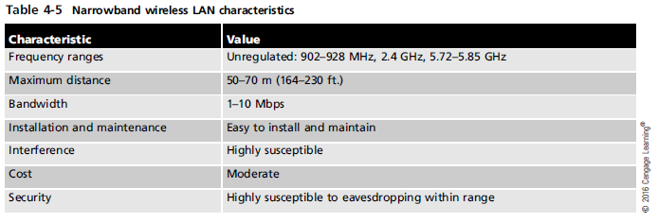
Narrowband Radio LAN Technologies
Notes:
Narrowband Radio LAN Technologies

Slide 55
Spread-Spectrum LAN Technologies
Uses multiple frequencies simultaneously, improving reliability and reducing susceptibility to interference
Also makes eavesdropping more difficult
Two main kinds of spread-spectrum communications
Frequency hopping – switches data between multiple frequencies at regular intervals
Direct-sequence modulation – breaks data into fixed-size segments called chips and transmits the data on several different frequencies at the same time
Notes:
Spread-Spectrum LAN Technologies
Uses multiple frequencies simultaneously, improving reliability and reducing susceptibility to interference
Also makes eavesdropping more difficult
Two main kinds of spread-spectrum communications
Frequency hopping – switches data between multiple frequencies at regular intervals
Direct-sequence modulation – breaks data into fixed-size segments called chips and transmits the data on several different frequencies at the same time

Slide 56
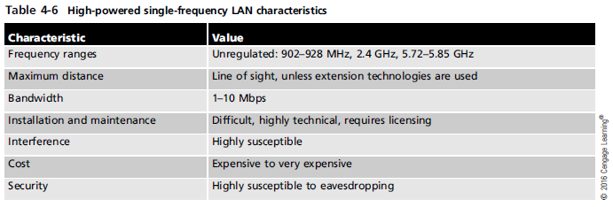
Spread-Spectrum LAN Technologies
Notes:
Spread-Spectrum LAN Technologies

Slide 57
LAN Media Selection Criteria
Three main media choices: UTP, fiber-optic, and wireless
When choosing between media types, consider:
Bandwidth – Higher bandwidth means more expensive cable and higher installation costs
If 40 Gbps or more, fiber-optic is the only choice
Budget – A typical UTP cable installation cost $100 - $200 per cable run and fiber-optic might cost twice that much
Wireless have no physical installation costs but you need to install access points and verify connectivity
Notes:
LAN Media Selection Criteria
Three main media choices: UTP, fiber-optic, and wireless
When choosing between media types, consider:
Bandwidth – Higher bandwidth means more expensive cable and higher installation costs
If 40 Gbps or more, fiber-optic is the only choice
Budget – A typical UTP cable installation cost $100 - $200 per cable run and fiber-optic might cost twice that much
Wireless have no physical installation costs but you need to install access points and verify connectivity

Slide 58
LAN Media Selection Criteria
When choosing between media types, consider:
Environmental considerations – How electrically noisy is the environment? How important is data security?
The more weight either factor has, the more likely fiber-optic or secured wireless is the right choice
Span – What kind of distance must the network span?
Longer spans might require fiber-optic or wireless be used between buildings
Strategic placement of small switches or hubs gives UTP surprising reach
Existing cable plant – For an upgrade, the existing cable plant must be considered
Notes:
LAN Media Selection Criteria
When choosing between media types, consider:
Environmental considerations – How electrically noisy is the environment? How important is data security?
The more weight either factor has, the more likely fiber-optic or secured wireless is the right choice
Span – What kind of distance must the network span?
Longer spans might require fiber-optic or wireless be used between buildings
Strategic placement of small switches or hubs gives UTP surprising reach
Existing cable plant – For an upgrade, the existing cable plant must be considered

Slide 59
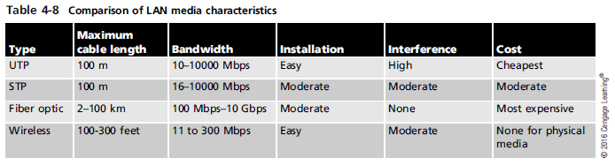
LAN Media Selection Criteria
Notes:
LAN Media Selection Criteria

Slide 60
Summary
Wired networking media come in two primary categories: copper and fiber-optic
Twisted pair cabling come in shielded or unshielded varieties
Twisted pair cabling components consist of connectors, patch cable, jacks, patch panels and distribution racks
A structured cabling plant consists of work areas, horizontal wiring, telecommunications closets, equipment rooms, backbone cabling, and entrance facilities
Notes:
Summary
Wired networking media come in two primary categories: copper and fiber-optic
Twisted pair cabling come in shielded or unshielded varieties
Twisted pair cabling components consist of connectors, patch cable, jacks, patch panels and distribution racks
A structured cabling plant consists of work areas, horizontal wiring, telecommunications closets, equipment rooms, backbone cabling, and entrance facilities

Slide 61
Summary
Fiber-optic uses pulses of light to represent bits and is immune to EMI, RFI and electronic eavesdropping
Wireless networks can be subdivided into LANs, extended LANs, and mobile computing
Components of a wireless LAN are a NIC, an antenna, and a transceiver or access point
Technologies used to transmit and receive data including: infrared, laser, narrowband radio and spread-spectrum radio
Networks combining fiber-optic, UTP, and wireless have become the norm
Notes:
Summary
Fiber-optic uses pulses of light to represent bits and is immune to EMI, RFI and electronic eavesdropping
Wireless networks can be subdivided into LANs, extended LANs, and mobile computing
Components of a wireless LAN are a NIC, an antenna, and a transceiver or access point
Technologies used to transmit and receive data including: infrared, laser, narrowband radio and spread-spectrum radio
Networks combining fiber-optic, UTP, and wireless have become the norm
longer distances in two or more geographical areas

